Slide 1

1 - <number>

Slide 2
Call socket()
A call to socket() with the proper arguments creates the Unix socket
A socket is an endpoint of an inter-process communication flow across a computer network.
Used to perform network input/output operations
Socket is the which function initiates the process
1 - <number>

Slide 3
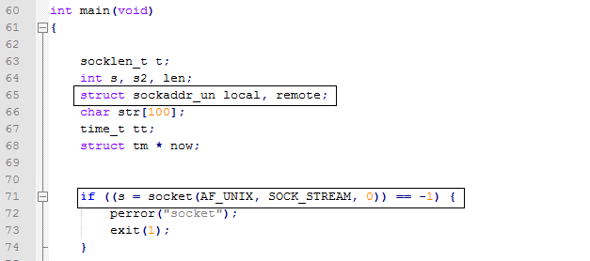
Code Snippet for socket()
1 - <number>

Slide 4
Call socket()
The second argument, SOCK_STREAM, tells socket() to create a stream socket
All these calls return -1 on error and set the global variable errno to reflect whatever went wrong
The AF_UNIX socket family is used to communicate between processes on the same machine efficiently.
SOCK_STREAM: for a stream-oriented socket
1 - <number>

Slide 5
Call bind()
The bind function assigns a local protocol address to a socket.
Header file :#include <sys/socket.h>
Syntax:
  int bind (int sockfd, const struct sockaddr *myaddr, socklen_t addrlen);
  Returns: 0 if OK and -1 on error
We use bind to tell sockets which port we want to serve.
A 0 value for port number means system will choose a random port
1 - <number>

Slide 6
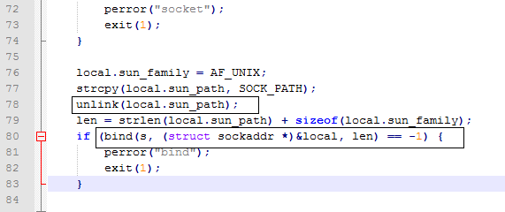
Code Snippet for bind()
1 - <number>

Slide 7
Unlink()
Function: Delete a name and possibly the file it refers to
Called unlink() before bind() to remove the socket if it already exists.
unlink() deletes a name from the filesystem. If that name was the last link to a file and no processes have the file open
1 - <number>

Slide 8

Unlink()
RETURN VALUE : On success, zero is returned. On error, -1 is returned, and errno is set appropriately.
Code Snippet:
1 - <number>

Slide 9
Listen()
The listen function is called only by a TCP server and it performs two actions:
  The listen function converts an unconnected socket into a passive socket, indicating that the kernel should accept incoming connection requests directed to this socket.
  The second argument to this function specifies the maximum number of connections the kernel should queue for this socket.
1 - <number>

Slide 10
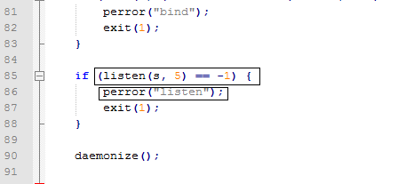
Listen()
Code Snippet:
The second argument, 5, is the number of incoming connections that can be queued before you call accept()
1 - <number>

Slide 11
Listen()
This instructs the socket to listen for incoming connections from client programs
Header file :#include <sys/socket.h>
Syntax:
  int listen (int sockfd, int backlog);
  Returns: 0 if OK and -1 on error
1 - <number>

Slide 12
accept()
The accept function is called by a TCP server to return the next completed connection from the front of the completed connection queue
If the completed connection queue is empty, the process is put to sleep
Header file :#include <sys/socket.h>
Syntax:
  int accept (int sockfd, struct sockaddr *cliaddr, socklen_t *addrlen);
The server accepts the connection by using the accept function.
  Returns: non-negative descriptor if OK, -1 on error
1 - <number>

Slide 13
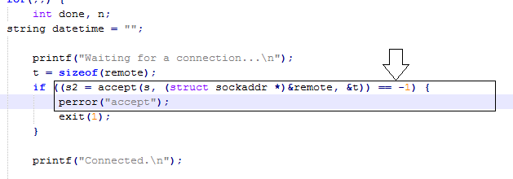
Code Snippet- accept()
Client Side:
1 - <number>

Slide 14
Accept()
This will accept a connection from a client
This function returns another socket descriptor
When accept() returns, the remote variable will be filled with the remote side's struct sockaddr_un
The descriptor s2 is connected to the client, and is ready for send() and recv()
1 - <number>

Slide 15
Umask()
umask - set file mode creation mask
Header file :#include <sys/types.h>, #include <sys/stat.h>
Syntax:
  mode_t umask(mode_t mask);
RETURN VALUE :
  This system call always succeeds and the previous value of the mask is returned.
1 - <number>

Slide 16
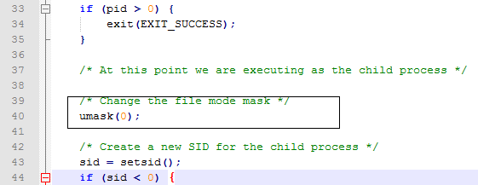
Code snippet – unmask()
umask() sets the calling process's file mode creation mask (umask) to mask
1 - <number>

Slide 17
Getppid()
getppid – get process identification
Header:
    #include <sys/types.h> #include <unistd.h>
Syntax:
    pid_t getpid(void); pid_t getppid(void);
getppid() returns the process ID of the parent of the calling process.
These functions are always successful.
1 - <number>

Slide 18
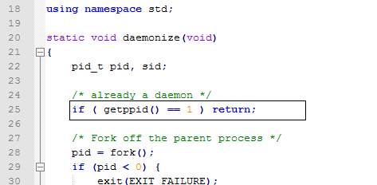
Code Snippet- Getppid()
1 - <number>

Slide 19


Perror()
perror - print a system error message
Header: #include <stdio.h>
Syntax: void perror(const char *s);
Code snippet :
1 - <number>

Slide 20
Send(),recv(),close()
Send(): The system call send() is used to transmit a message to another socket.
Recv(): The recv() calls is used to receive messages from a socket. It may be used to receive data on both connectionless and connection-oriented sockets
Close(): close() closes a file descriptor, so that it no longer refers to any file and may be reused.
1 - <number>

Slide 21
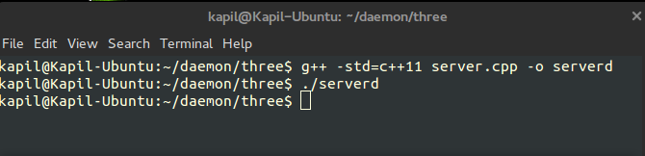
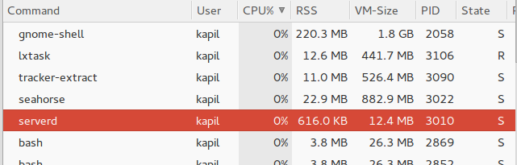
Output client side
Task manager showing daemon execution:
1 - <number>

Slide 22
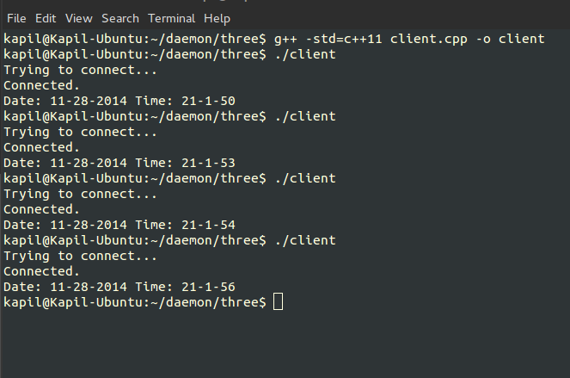
Output Server side
1 - <number>

